Slide 1

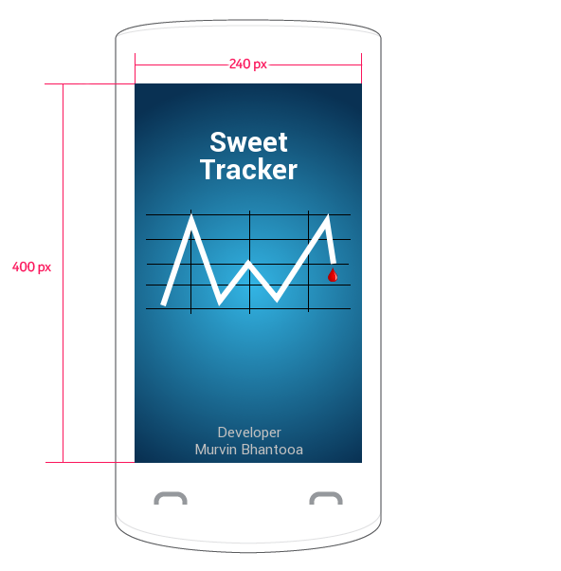
Sweet Tracker
Sweet Tracker is a blood sugar monitoring application designed to allow users to efficiently record their sugar levels, visualize the levels variations and effectively monitor their progress.
The application is secured via an optional PIN lock, supports 2 general themes and is translated in 5 languages.
Sweet Tracker is a brand new application created for the Asha Developer Competition. My motivation was to get the best performing and visually appealing application of its kind on the market place.

Slide 2
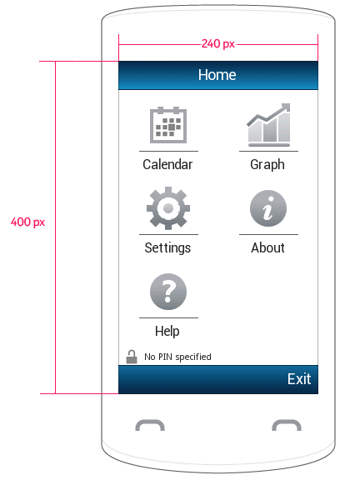
At a Glance
The home screen is loaded right after the application’s splash screen finishes. In case a PIN lock is set a dialog will appear prompting the user to authenticate before going any further. The lock is however off by default.
This screen contains the application’s main menu. A central point where everything else is accessible. Here the user can add an entry through the calendar, edit the settings, get help to understand the app and view monthly graphs of all entries.
The small padlock on the bottom left of the screen indicates the lock status. This is to bring privacy awareness to the user’s attention.

Slide 3
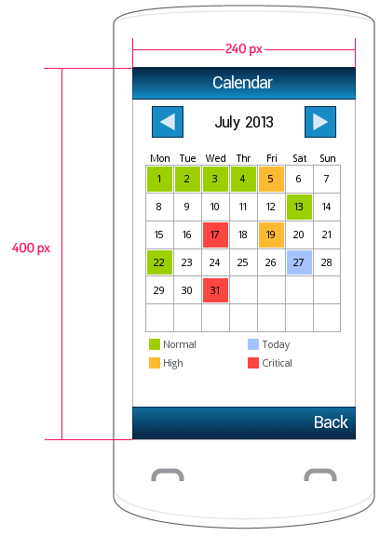
Calendar View
The calendar view shows a colour coded monthly view of all the user’s entries. The colour code consists of 3 levels, a green code for normal values, an amber one for high values and a red one for critical levels. A colour code is determined based on the user’s entered glucose level, the time interval of the meal and the user’s diabetic type. All ranges/diabetic types are set in the settings screen.
Tapping on a given day takes the user to the entry screen. If an entry exists already for this day the user can either delete or edit the entry. If no entry are found for this particular day the user can save the details or cancel it all together.

Slide 4
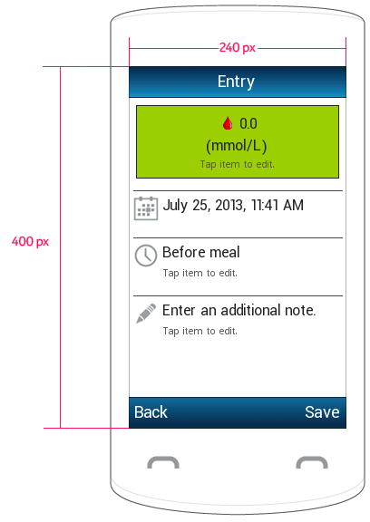
Adding an entry
Tapping the first list item will open up an entry dialog where the user can set his current glucose level. The meal time interval can also be changed by tapping the list entry with the small clock icon. This toggles from Before meal to 2 hours after meal.
The last option denoted by the small pen icon allows the user to enter additional text notes regarding this entry. Examples could be the circumstances under which the level was taken such as after a jog or a heavy meal. This note could then help the user understand why the current level is such at a later time.

Slide 5
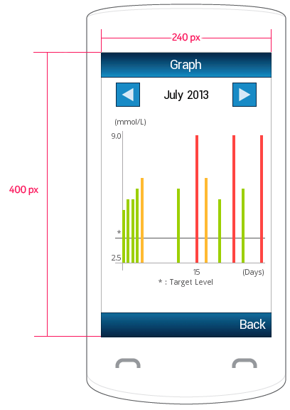
Visualisations
This screen contains monthly charts that gives a visualisation of the glucose levels variations for the user. The same colour code used in the calendar screen is maintained here. The user can see the minimum and maximum entries made for the month at a glance.
The chart component also has a horizontal grey line that shows the target set in the user’s settings. This can be evaluated against the levels of the entries made.

Slide 6
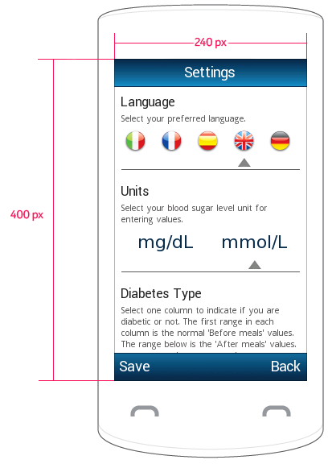
A lot of Settings
Sweet Tracker offers the user a considerable amount of settings to vary. One of the 5 supported languages can be chosen. The unit of glucose measurement can be toggled from mg/dL to mmol/L. The user can also specify the type of diabetes he/she has in case he/she is diabetic indeed.
The target level and PIN lock can also be set in the settings. Lastly the theme can be set. This changes the entire look and feel of the whole application instantly.
The ability to edit and change as much as possible gives the user a sense of control over the application. A lot of options have been crafted in so as to ensure users with different languages, colour preferences can equally enjoy the application.

Slide 7
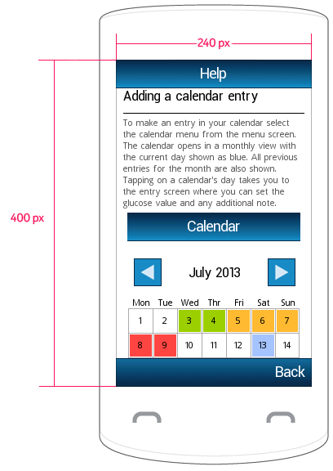
Help is at hand
A whole screen has been dedicated to helping the user using the application. Every feature is covered in the help section. It gives some background information on the features and contains screen shot sections of the various screens.

Slide 8
Conclusion
Sweet Tracker was designed with great attention to detail and with efficiency in mind. Every operation can be completed with just a few taps and confirmations. Animations effects are used for screen transitions and item entries to enhance the user experience.
The application offers a full set of features and is fun enough to engage the user make them adopt it.

